Slide 1

The European Association of Medical devices
Notified Bodies
Web Site - Presentation
2025
Copyright © Team-NB Team-NB Web Presentation 2025

Slide 2

Team-NB
Aims:
Represent Notified Bodies
Communication with
European Commission
European Medicines Agency
Competent Authorities
Industry
Others stakeholders
Promote technical and ethical standards
Participate in improving the legal framework
Contribute to harmonization (e.g. training ‘for notified bodies by notified bodies’)

Slide 3
Members
Members over the years from foundation in 2001
42 members representing 19 different countries including new category of NBs: 2 in the designation process

Slide 4

Code of Conduct - Version 5
Version 5.0 approved on September 2024 and signed by all Members
Removal of references to Directives and general update of references and terminology
Compliant with MDCG Guidance and TeamNB & NBCG-Med Papers
Estimation of time needed for Technical Documentation review included
Clarified requirements for unannounced audit
Detailed explanation of re-certification requirements
Estimation of time needed for CAPA
Included examples for Structured Dialogue
Enforcement changed to complaint / appeal process
Mandatory to sign for TEAM-NB members
Available on website : www.team-nb.org

Slide 5
Interpretation of the new regulations
Team-NB established working groups from 2016
Aims
Help members to be designated
Allow harmonization

Slide 6
Implementation of new regulations
MDCG mirror WGs
Aims
to allow notified bodies members to speak of 1 voice
to prepare and participate in the MDCG meetings
to write reports
distributed to all members
to share information
to comment on MDCG proposals
to write Position Papers (published on Team-NB web site)

Slide 7
Implementation of new regulations
Task Forces
Aims
to address specific topics of NBs interest
Class D specific requirements
Medical Gas Systems
Artificial Intelligence
IVDR Harmonisation
Code of Conduct
Orphan Devices
Cybersecurity
PSUR / CEAR
Lifetime
…
to write Position Papers (published on Team-NB web site)
to harmonise
views
practises

Slide 8
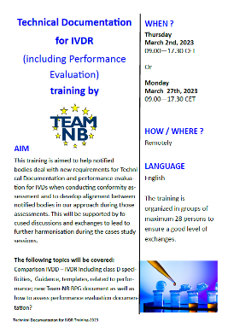
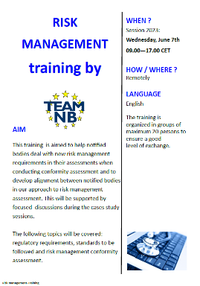


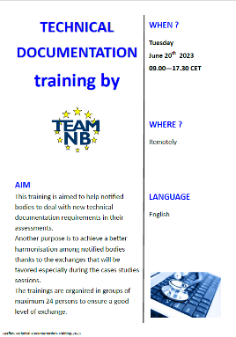

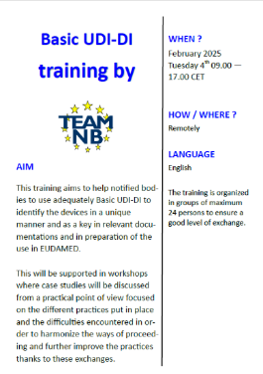


Implementation of new regulations
Trainings
Aims
to help NBs to deal with new MDR / IVDR requirements in their assessment.
to achieve a better harmonisation among NBs thanks to the exchanges
Trainings Topics
MDR PMS
Basic UDI-DI
Hybrid Audits
MDR Software
MDR Annex XVI
MDR Clinical Data
Risk Management
Subtance Based Devices
IVDR Technical Documentaion
MDR Technical Documentation

Slide 9


Implementation of new regulations
Experts sessions
Aims
to support NBs
To allow for a harmonised approach across all notified bodies interpretation
for senior experts to share their experience on burning topics
with attendees to cascade the info into their organisation to reach all reviewers

Slide 10
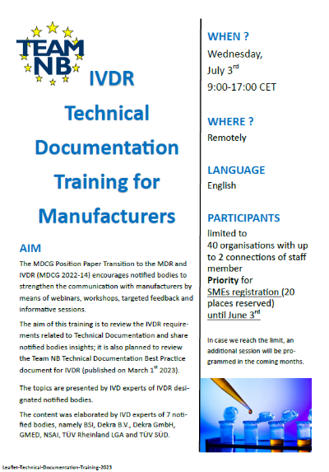
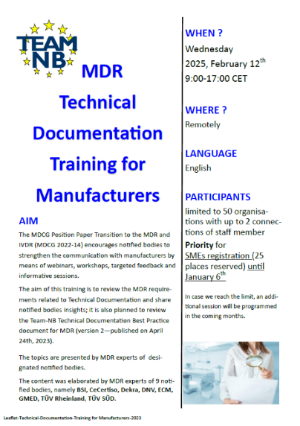
Implementation of new regulations
Trainings for Manufacturers
Aims
to review the MDR requirements related to technical documentation and share notified bodies insights
to review the Team-NB technical documentation best practice document for MDR

Slide 11
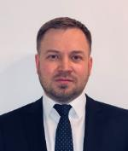
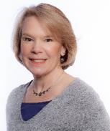
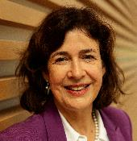
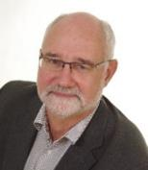
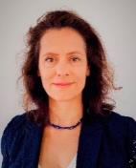
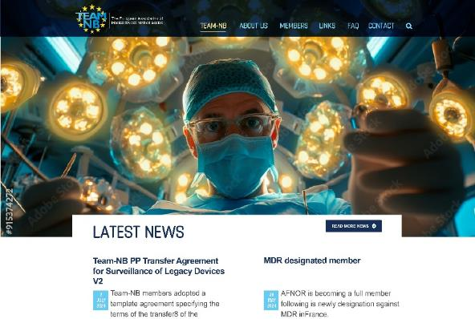
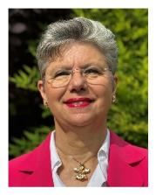
Contacts
Administrative Commitee:
President Alexey Shiryaev | Vice-President Suzanne Halliday | Vice-President Sabina Hoekstra- van den Bosch | Treasurer Gero Viola | Secretary Béatrice Lys
DNV | BSI | TÜV SÜD | TÜV Rheinland | GMED
Management:
Web site:
www.team-nb.org
Director
Françoise
Schlemmer

Slide 12


































Members
Note : some members of the same group are represented by only 1 logo

